Slide 1


WELCOME TO FIGMA
PRESENTATION
CLICK HERE TO OPEN FIGMA PROJECT
CLICK HERE TO OPEN GITHUB LINK

Slide 2


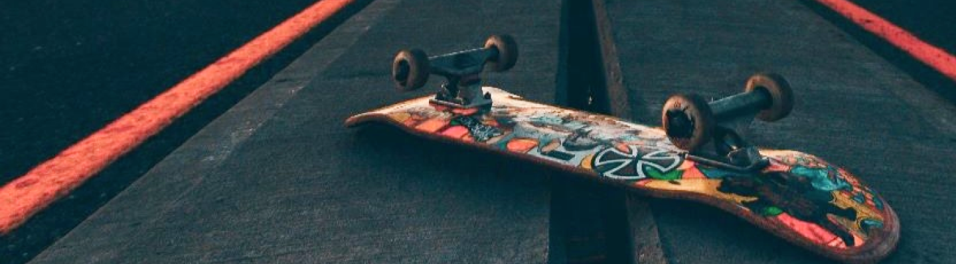
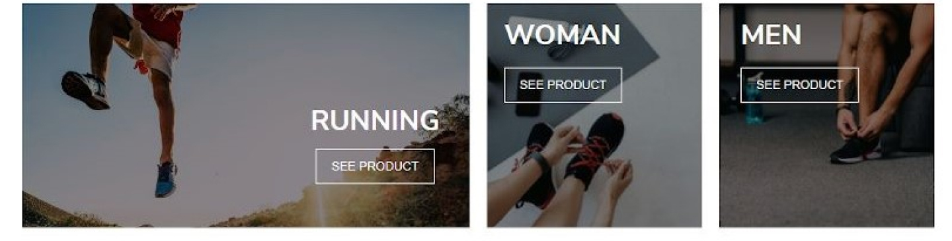
SEARCH
SIGN IN
CHAMPION SPORT

Slide 3
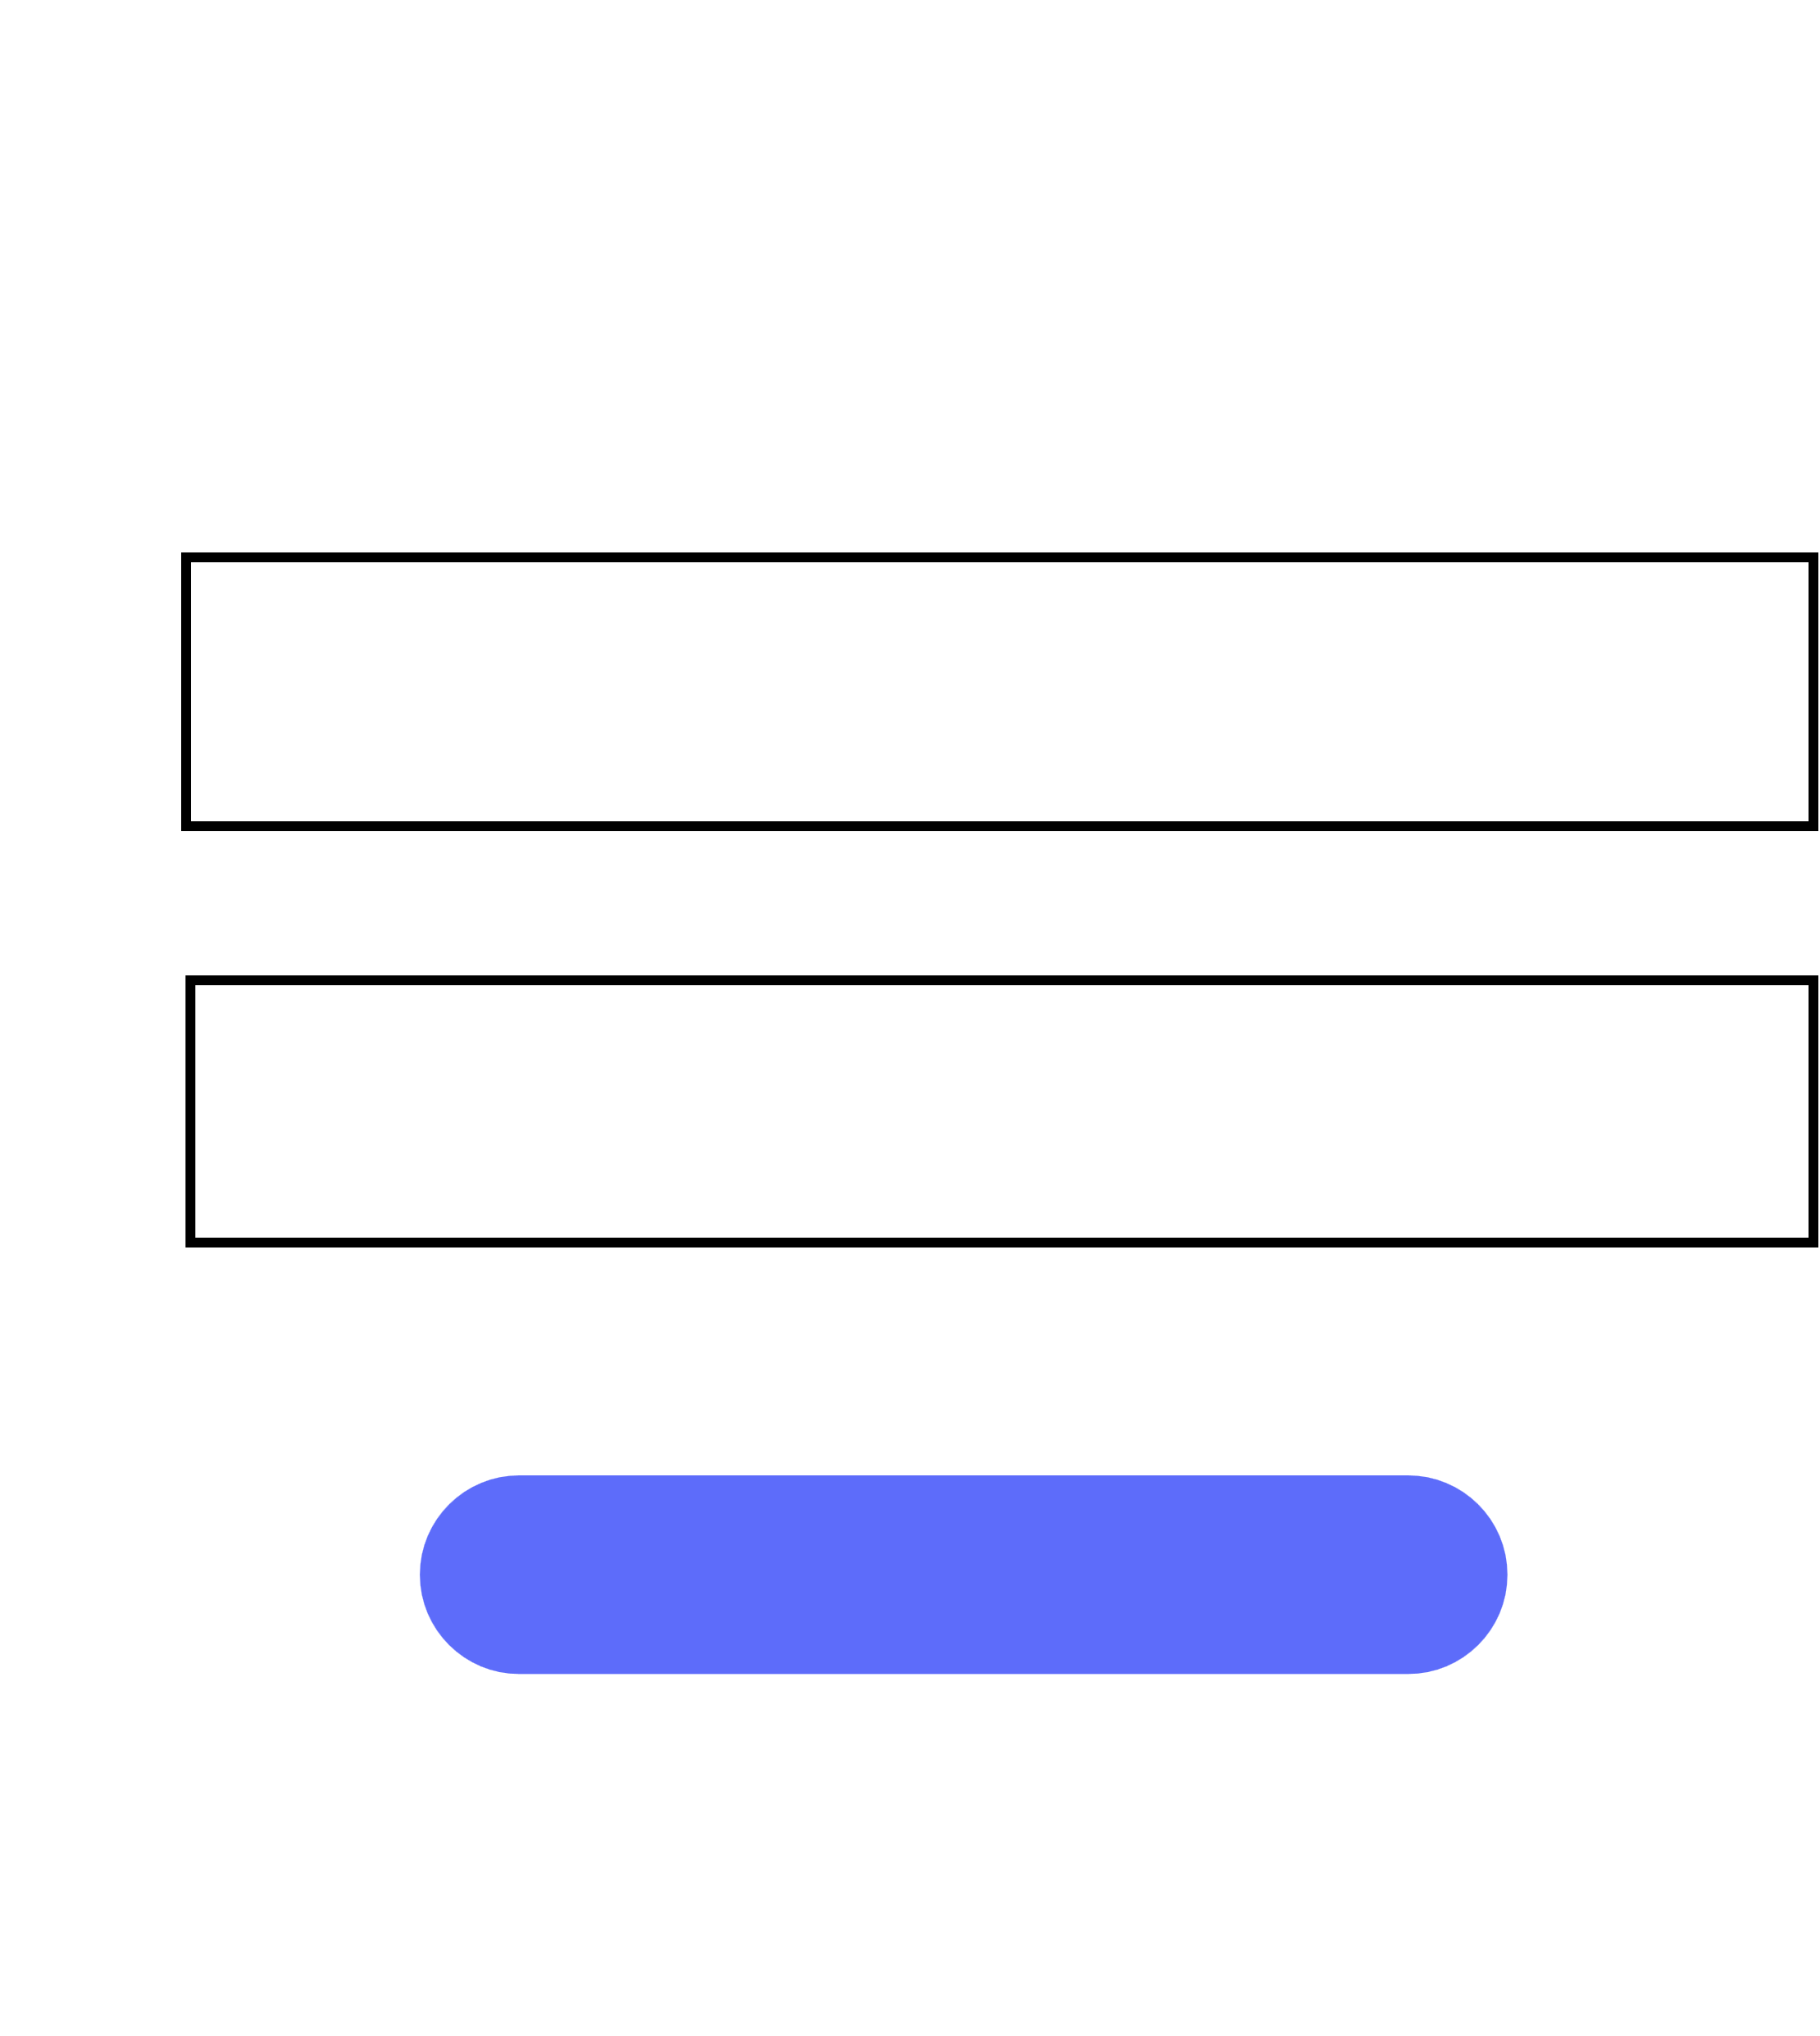





WELCOME !!!
LOGIN
USERNAME
PASSWORD
FORGOT PASSWORD ?
LOGIN
LOGIN WITH
new user ? click here

Slide 4











SIGN UP HERE
ENTER USERNAME
ENTER PASSWORD
CONFIRM PASSWORD
CREATE
OR LOGIN WITH
SIGN IN WITH GOOGLE
SIGN IN WITH TWITTER

Slide 5







RESET PASSWORD
ENTER YOUR MAIL AND WE WILL SEND YOU A LINK TO RESET YOUR PASSWORD
ENTER YOUR MAIL
CONTINUE
<-- BACK TO LOGIN

Slide 6




Sign in
with your google account
Email or phone
Forgot Email?
Not your computer? Use guest mode to sign in privately
Learn more?
Create Account
Next

Slide 7



Welcome
********@gmail.com
Enter Your Password
Show password
Forgot Password?
Next

Slide 8




LOGIN SUCCSESSFULL !!!
You have succsessfully loged in.Wish you have a nice experience.
GET STARTED

Slide 9



Change Password
********@gmail.com
Create a strong password
Create a new, strong password that you don’t use for other websites
Create Password
Confirm
Show password
Skip
Save Password

